Slide 1
Identity Server 4 & Making OAuth Easy
Brett Berliner

Slide 2
About me
Brett Berliner (bberliner@cardinalsolutions.com)
11 years in Columbus industry (mostly .NET)
Last 5 years, focused on cloud solutions with Azure / AWS
Coming off of surge week and vacation
All material available on github.com/brettberliner

Slide 3
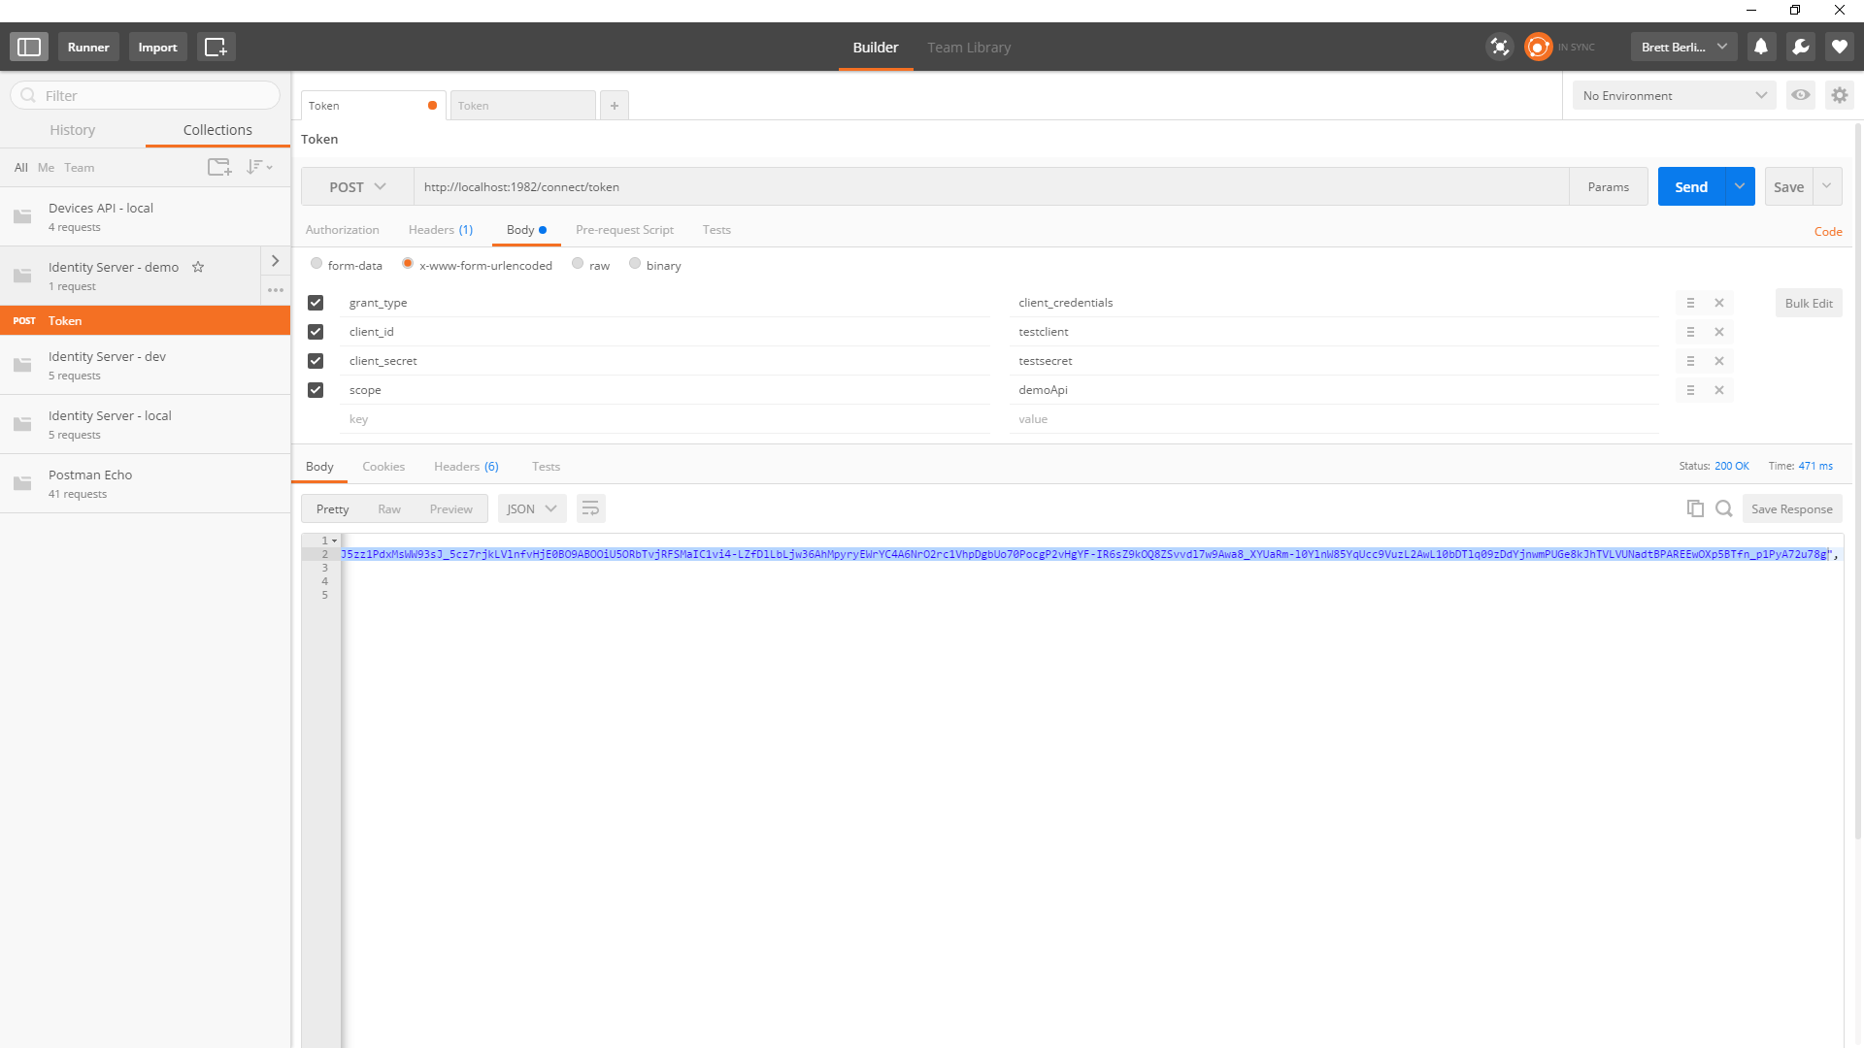
Postman – your best friend

Slide 4
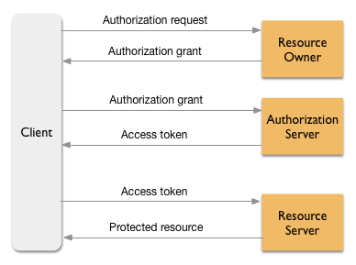
About OAuth
Open standard for authorization
Adopted by large companies such as Google & Facebook
Currently on 2.0 to separate flows by device type (web, desktop, mobile, etc)
(Image courtesy of Apigee Product Documentation)

Slide 5
OAuth troubles
Fairly easy to build the API endpoints individually, but there are a ton of tokens
Provisioning tokens and building claims can be difficult and fragile
Simple grant types are easy but using claims and complex registration can be difficult
Is security implementation strong enough to protect but easy enough to change if compromised?

Slide 6
Identity Server 4
https://github.com/IdentityServer/IdentityServer4
Open source token provisioning and credential management software
Highly extensible and configurable
V4 optimized for .NET core in late 2016

Slide 7
Token Types
JWT – JSON Web Tokens (jwt.io) – no refresh
Reference token
Grant Types
Implicit
Authorization code
Hybrid (combines 1 & 2)
Client credentials
Resource owner password
Refresh tokens
Extension grants
Other Terms
Secrets
Claims

Slide 8
Default Endpoints
/.well-known/openid-configuration (Discovery endpoint)
/connect/authorize (Request tokens/codes via browser)
/connect/token (Provision token)
/connect/userinfo (Identity information)
/connect/introspection (Token information)
/connect/revocation (Revoke token)

Slide 9
Installation
New .NET core project, set to self hosting (defaults to port 5000)
“Install-Package IdentityServer4”
Startup.cs – Configure, add line “app.UseIdentityServer();”

Slide 10
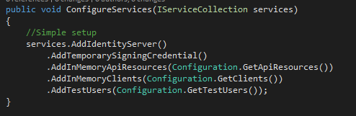
Simple Setup – Startup.cs

Slide 11
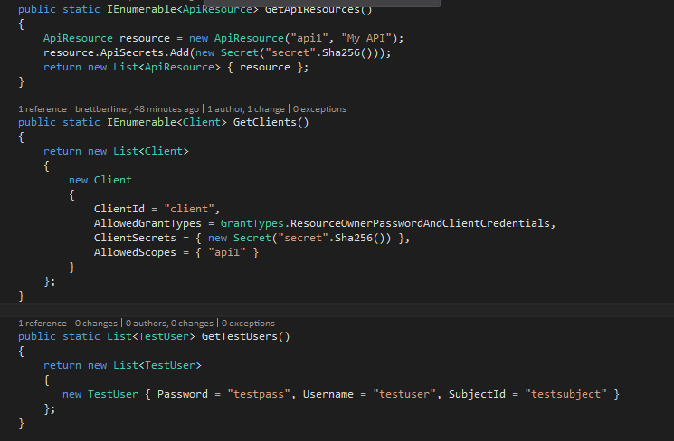
Simple Setup – Configuration

Slide 12
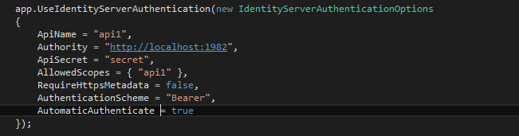
Authentication
project.json - "IdentityServer4.AccessTokenValidation": "1.0.1“
Add to web Startup.cs before app.UseMvc
Attach [Authorize] attribute to header with optional policies

Slide 13

User Validation
Used in grant type password to perform credential validation
Create custom claims to be stored against the token for further validation

Slide 14
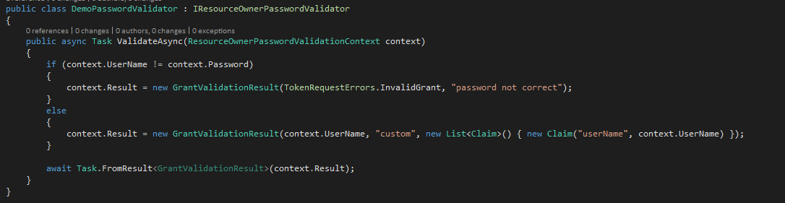
Validation Example

Slide 15
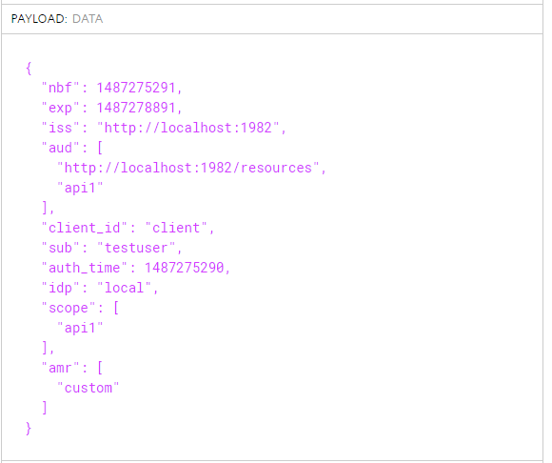
Validation Result

Slide 16
Data Contexts
docs.identityserver.io/en/release/quickstarts/8_entity_framework.html
EF migration available to build the database structure
project.json “IdentityServer4.EntityFramework” : “1.0.0”
.AddConfigurationStore(builder => builder.UseSqlServer(dbContext.Database.Connection)
(Currently not present in demo)

Slide 17
More Information
github.com/IdentityServer/IdentityServer4
github.com/brettberliner
docs.identityserver.io
scottbrady91.com/Identity-Server/Getting-Started-with-IdentityServer-4

